Slide 1
COVID-19 Cases-part-4
File created on: 30-03-2020 17:46:51

Slide 2
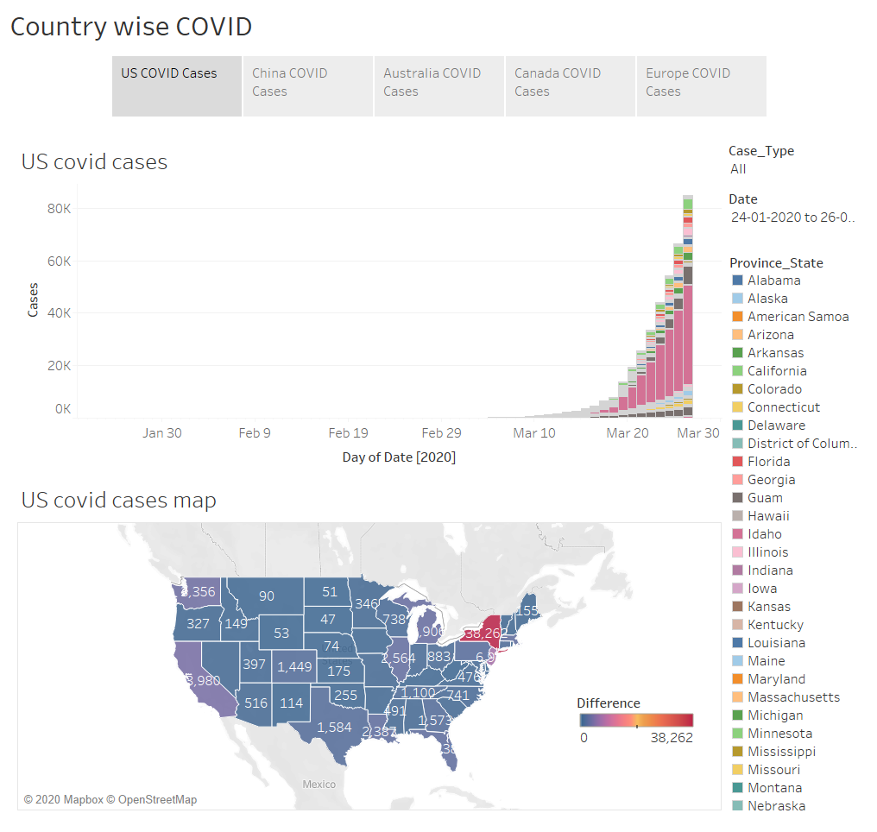

Slide 3
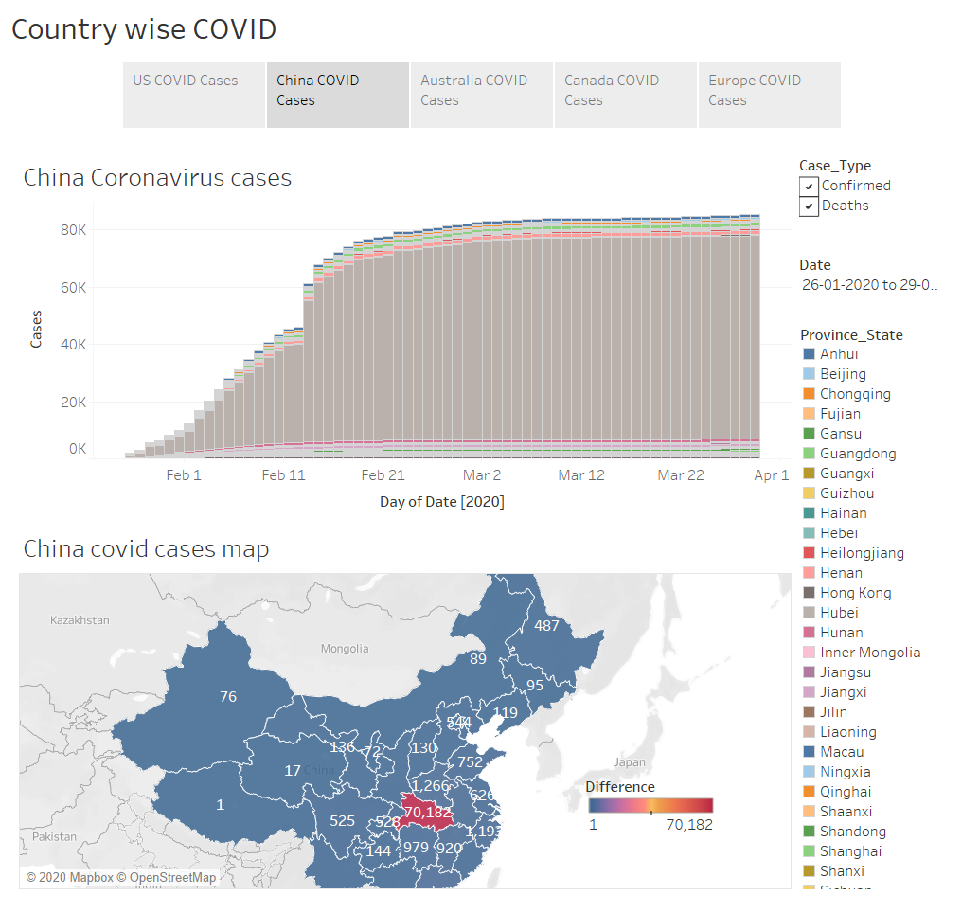

Slide 4
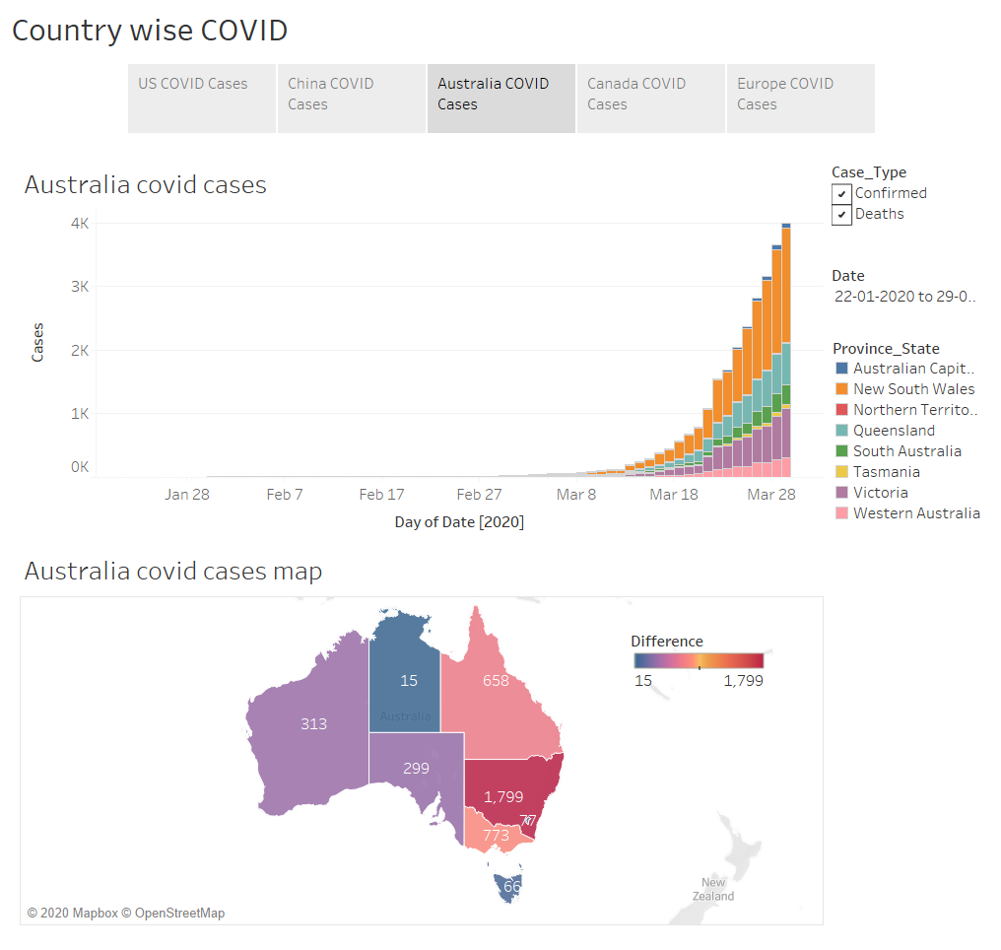

Slide 5
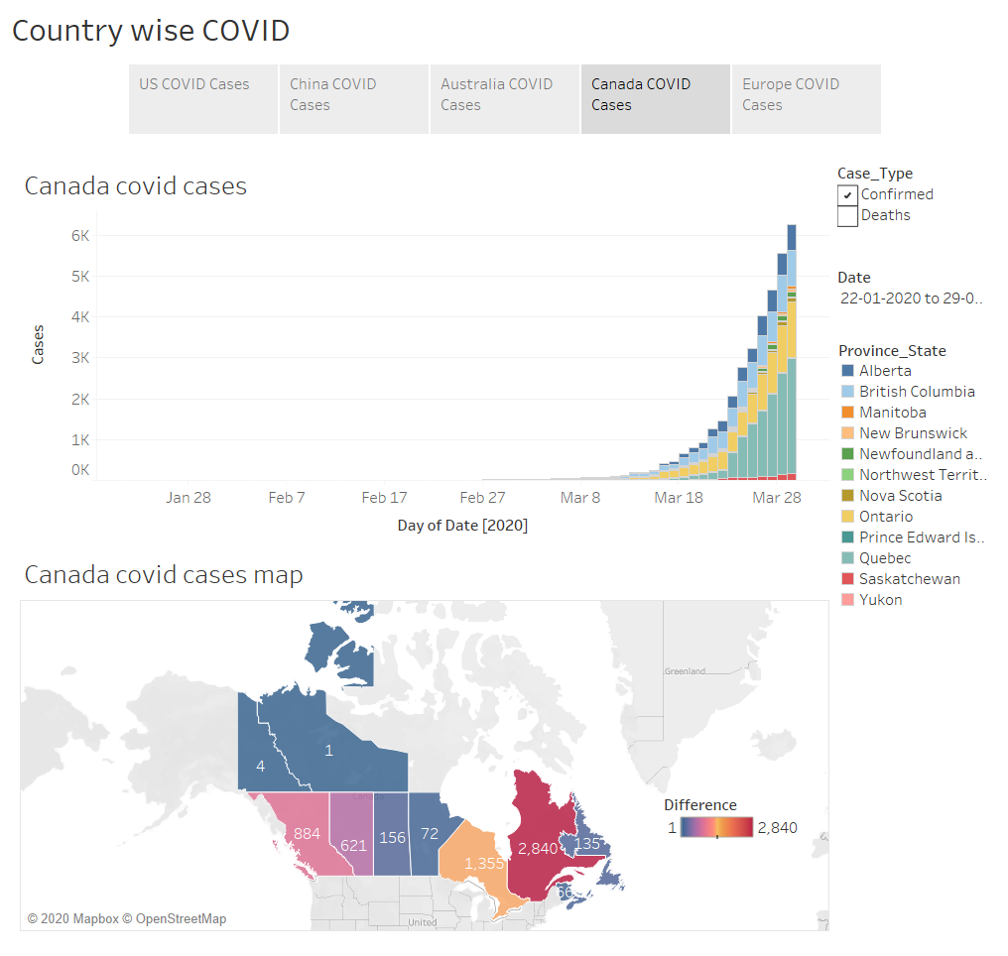

Slide 6
